Slide 1


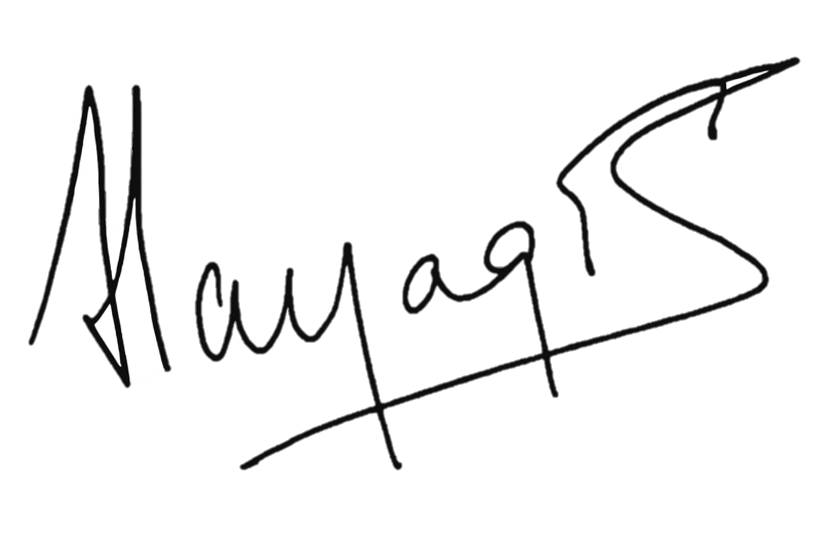
 | Stellar Optics Private Limited | SOPL – AQMS - 01
 | VISION
Jan 2025 Rev No :00 Director
To be the leading innovator in precision optics, advancing technology through design and manufacture of cutting-edge lenses and optical systems.

